Slide 1
TOPIC 2 · DEEP DIVE
The Six Data Mining Functions
What data mining can actually find — each function produces a different kind of pattern.
1
Generalization
2
Association
3
Classification
summarize & describe data
find what occurs together
predict a known label
DESCRIPTIVE
DESCRIPTIVE
PREDICTIVE
4
Cluster Analysis
5
Outlier Analysis
6
Trend & Sequence
group similar, unlabeled data
flag the rare & abnormal
patterns over time & order
DESCRIPTIVE
DESCRIPTIVE
PREDICTIVE
Notes:
Overview of the six data mining functions. These are the detailed functionalities under the descriptive/predictive split.

Slide 2
Generalization: From Raw Data to Summary
Prepare storage, organize it, build a cube, then summarize.
Raw Sources
Data Warehouse
OLAP Cube
OLAP Operations
Generalized
Summary
many systems,
messy data
cleaned, integrated
historical data
1 fact ×
few dimensions
roll-up, slice,
summarize
compact,
high-level view
INSIDE THE WAREHOUSE: STAR SCHEMA
WHAT GENERALIZATION PRODUCES
Product
Region
Characterization — summarize ONE class
e.g. "describe the dry region"
FACT TABLE
sales amount
Time
Customer
Discrimination — contrast TWO classes
e.g. "dry region vs wet region"
Notes:
Generalization pipeline: raw sources -> data warehouse (star schema: central fact table + dimension tables) -> OLAP cube (one fact, chosen dimensions) -> OLAP operations (roll-up, slice, summarize) -> generalized summary. Two outputs: characterization (describe one class) and discrimination (contrast two).

Slide 3
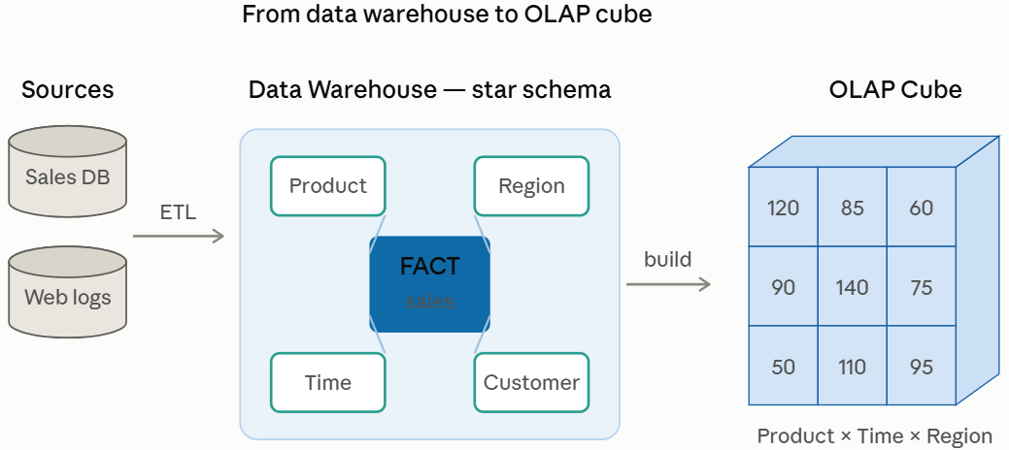
Summarize and describe data at a higher, more abstract level.
FUNCTION 1
Generalization
EXAMPLE
Summarize the weather of a "dry region" and contrast it with a "wet region" — generalizing thousands of daily records into a few descriptive traits.
1
Builds a data warehouse first: cleaning, transformation, integration into a multidimensional data model.
Uses data cube technology — scalable methods for computing multidimensional aggregates (OLAP: online analytical processing).
Characterization: summarize the general features of a target class.
Discrimination: contrast one class against another.
THINK OF IT AS
Zooming out. Raw rows → roll-up → a short, high-level summary a manager can read at a glance.

Slide 4
FUNCTION 2
Association & Correlation Analysis
Discover items or events that frequently occur together.
2
Finds frequent patterns (frequent itemsets): what is bought together?
A rule is written as A → B, scored by support (how often) and confidence (how reliably).
Watch out: association is not causality — items may correlate without one causing the other.
Algorithms mine these rules efficiently even in very large datasets (Apriori, FP-Growth).
CLASSIC EXAMPLE
Diaper → Beer [support 0.5%, confidence 75%]
Customers who buy diapers often also buy beer, so the store can place them nearby.
SUPPORT vs CONFIDENCE
Support = how frequently the combo appears.
Confidence = how often B follows when A is bought.

Slide 5
FUNCTION 3
Classification
Predict a category (label) that is known in advance — supervised learning.
3
Construct a model from labelled training examples.
The model describes and distinguishes classes so it can predict labels for new, unseen data.
Typical methods: decision trees, naïve Bayes, support vector machines, neural networks, logistic regression.
Key point: the classes are predefined — labels are known before training.
EXAMPLE
Train on past emails labelled "spam" / "not spam", then automatically classify every new incoming email into one of those classes.
WHERE IT IS USED
Credit-card fraud detection, direct marketing (will they respond?), classifying stars, diseases, and web pages.

Slide 6
FUNCTION 4
Cluster Analysis
Group similar data into natural categories — unsupervised learning.
4
Unsupervised: the class label is unknown — the groups are discovered, not given.
Groups data to form new categories (clusters) from the data itself.
Principle: maximize similarity within a cluster and minimize similarity between clusters.
Contrast with classification: here no labels exist beforehand.
EXAMPLE
Cluster houses in a city by price and location to reveal distribution patterns — natural neighbourhoods emerge without any labels.
CLASSIFICATION vs CLUSTERING
Classification = labels known (supervised).
Clustering = labels discovered (unsupervised).

Slide 7
FUNCTION 5
Outlier Analysis
Find the rare data points that do not fit the general behaviour.
5
An outlier is a data object that does not comply with the general behaviour of the data.
Noise or exception? — "one person’s garbage could be another person’s treasure."
Often found as a by-product of clustering or regression analysis.
Frequently the outlier is the most valuable finding, not something to discard.
EXAMPLE
A credit card normally used locally suddenly makes a large purchase abroad at 3 a.m. — an outlier flagged as likely fraud.
USEFUL FOR
Fraud detection, network-intrusion alerts, and rare-event analysis — anywhere the unusual matters more than the typical.

Slide 8
FUNCTION 6
Time, Trend & Sequential Analysis
Patterns that depend on time and ordering.
6
Trend & time-series analysis: model change over time (e.g. regression and value prediction).
Sequential pattern mining: events that happen in a certain order.
Periodicity analysis: repeating cycles (seasonality).
EXAMPLE
Customers first buy a digital camera, then later buy a large SD memory card — a sequential pattern a store can act on.
KEY IDEA
Order and timing carry information. What comes next, and when, is often as important as what occurs.

Slide 9
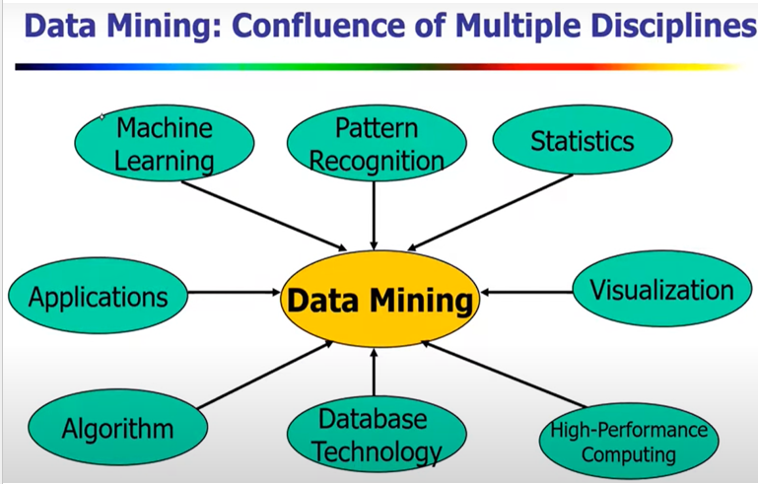
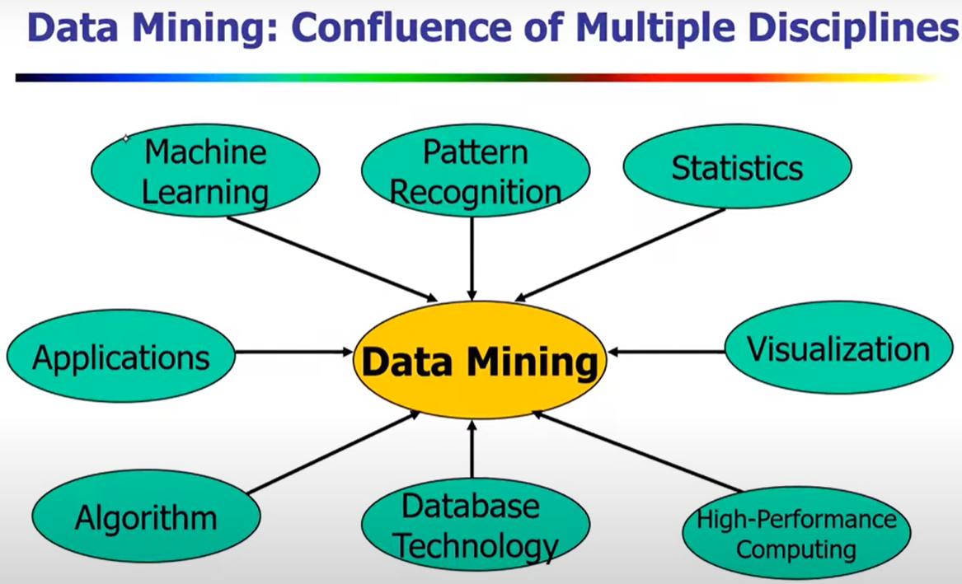
Data mining is inherently interdisciplinary — it sits at the intersection of ML, statistics, databases, algorithms, computing, visualization, and real-world applications. It doesn't replace those fields;
it combines their strengths to extract knowledge from data.

Slide 10
WHERE IT IS USED
Applications of Data Mining
The six functions power real decisions across many industries.
Retail & E-commerce
Banking & Finance
Healthcare
Market-basket analysis and recommendations — "customers who bought this also bought…".
Credit-card fraud detection and credit-risk scoring by spotting abnormal transactions.
Disease diagnosis, patient-risk prediction, and grouping similar cases for treatment.
Uses: Association
Uses: Outlier · Classification
Uses: Classification · Clustering
Telecom & Marketing
Web & Social Media
Science & Industry
Customer segmentation and churn prediction to target offers and reduce cancellations.
Clickstream analysis, search ranking, and recommendation of content and ads.
Bioinformatics, weather forecasting, and sensor/quality monitoring in manufacturing.
Uses: Clustering · Classification
Uses: Association · Sequence
Uses: Trend · Outlier
Notes:
Applications of data mining across industries, each mapped to the functions it uses: retail (association), banking (outlier/classification), healthcare (classification/clustering), telecom (clustering/classification), web (association/sequence), science (trend/outlier).

Slide 11
Types of Attributes

Slide 12
UNDERSTAND YOUR DATA
Types of Attributes
The kind of value an attribute holds decides which operations and mining methods are valid.
Types of Attributes
Qualitative (categorical)
Quantitative (numeric)
NOMINAL
ORDINAL
INTERVAL
RATIO
Nominal
Ordinal
Interval
Ratio
names, no order — e.g. colour, gender
ordered, unequal gaps — e.g. S < M < L
equal gaps, no true zero — e.g. °C, year
true zero, ratios valid — e.g. weight, income
Notes:
Overview of attribute types. Parent: Types of Attributes -> Qualitative (nominal, ordinal) and Quantitative (interval, ratio). The following four slides cover each in detail.

Slide 13
DATA TYPE 1 · QUALITATIVE
Nominal (Categorical) Attributes
Names or labels with no order and no numeric meaning.
A
Values are categories or labels that simply name something — pure classification, no ranking.
No inherent order: one value is not "greater" or "less" than another.
Even if coded as numbers (e.g. 1=male, 2=female), the numbers are just IDs — arithmetic is meaningless.
Only valid operation: equality check (= or ≠) and counting frequencies (mode).
EXAMPLES
Gender: male, female
Colour: red, green, blue
Marital status, ZIP code, blood type (A, B, AB, O).
WHY IT MATTERS
You cannot average or rank nominal data. "Average blood type" is nonsense. In data mining, nominal attributes are used for grouping, counting, and classification — not for calculations.

Slide 14
DATA TYPE 2 · QUALITATIVE
Ordinal Attributes
Categories that DO have a meaningful order — but unequal gaps.
B
Values have a clear rank or order (low → high), so you can say one is greater than another.
BUT the distance between ranks is not measurable or equal.
The difference between "good" and "very good" is not the same size as between "poor" and "fair".
Valid operations: order comparisons (<, >) and median — but NOT addition or averaging.
EXAMPLES
Satisfaction: poor < fair < good < excellent
Education: high school < bachelor < master
T-shirt size (S, M, L), class grades (A, B, C).
NOMINAL vs ORDINAL
Nominal = names, no order (colour).
Ordinal = names WITH order, but gaps are not equal (small/medium/large).

Slide 15
DATA TYPE 3 · QUANTITATIVE
Interval Attributes
Numeric with equal gaps — but NO true zero.
C
Numeric values where the difference between them is meaningful and equal-sized.
You CAN add and subtract: the gap from 10° to 20° equals the gap from 20° to 30°.
BUT there is no true zero — zero does not mean "none". 0°C is not "no temperature".
So ratios are meaningless: 20°C is NOT "twice as hot" as 10°C.
EXAMPLES
Temperature in °C or °F
Calendar dates / years (year 0 is arbitrary)
IQ scores, pH level.
THE KEY LIMITATION
Because zero is arbitrary, you can compare differences but not ratios. You can say "10° warmer", but never "twice as warm". This is what separates interval from ratio data.

Slide 16
DATA TYPE 4 · QUANTITATIVE
Ratio Attributes
Numeric with equal gaps AND a true zero — the richest type.
D
Numeric values with equal intervals AND a meaningful true zero (zero = none of the quantity).
Because zero is real, ALL operations are valid: +, −, ×, ÷ and ratios.
You can say "twice as much": 10 kg is genuinely twice 5 kg; ₹200 is twice ₹100.
The most informative attribute type — supports every statistical measure (mean, etc.).
EXAMPLES
Weight, height, age, income
Distance, count of items, salary
Temperature in Kelvin (0 K = true zero).
INTERVAL vs RATIO
Interval = no true zero → differences only (°C).
Ratio = true zero → ratios valid (weight, income). "Twice as much" only makes sense here.

